Slide 1

Ming-Young Tam
Corinne LaBossiere
* Riccardo Muti
Kassidy Huynh
* Jigdel Kuyee
* Dave Piccin
Izabella Wilczynska
Project Advisor
Engagement Manager
Senior Consultant
Consultant
Consultant
Consultant
Consultant
Final
Review
February 20, 2010

Slide 2
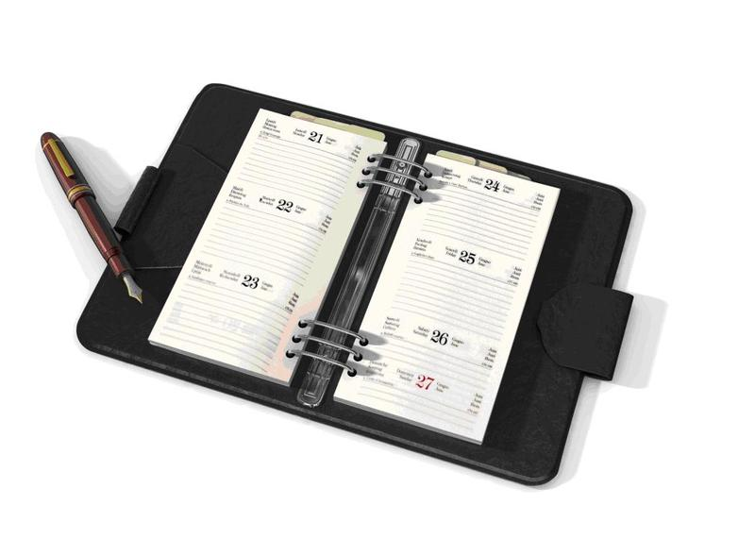
Agenda
Review
Highlights of Findings and Recommendations
Next Steps
Discussion

Slide 3

Review

Slide 4
Review
Protect child victims of abuse whose images are shared on the internet
Challenges
Lack of sustainable financial support
Lack of strategic communications approach
Limited resources and infrastructure
Identifying potential supporters
Determining right messaging
Determining right tactics and tools
Objectives (focus on communications)
Identify key opportunities and obstacles to achieving fundraising goals
Identify target audiences
Determine what they know and think about KINSA
Determine best ways to reach and influence them

Slide 5
Approach & Accomplishments
Phase I:
Phase II:
Phase III:
Phase IV:
Phase V:
Phase VI:
Analyze information collected in previous phase
Interview current and potential supporters
Interview fundraising experts
Analyze research performed in previous phases
Summarize findings and recommendations in a report and presentation
Collect information about KINSA
Interview staff, board members, and other stakeholders
Perform secondary research
Brainstorm ideas
Create recommendations
Identify Fundraising
Obstacles/Opportunities
Fundraising Tools and
Communication Activities
Opinions of Target
Audiences
Fundraising Best
Practices
Analyze Findings
Present Findings and
Recommendations

Slide 6

Highlights of Findings and Recommendations

Slide 7

Goals and Strategies
Finding:
Lacking specific, documented goals
Recommendation:
Develop a sustainability plan

Slide 8
Target Audiences
Corporations
Government
Foundations
Individuals
Federal
Corporate
High net worth
Information Technology and Telecommunications
Financial Services
Consumer Packaged Goods
Ministry of Foreign Affairs
Provincial
Task Force on Internet Crimes Against Kids
CIDA
Private
Cause
Community
Ministry of Public Safety
Mothers, parents, grandparents

Slide 9
Information Needs
Practical:
Goals and plans
Impact of donations
Measurable accomplishments
Emotional:
Significance
Success stories
Testimonials
Case for Support

Slide 10
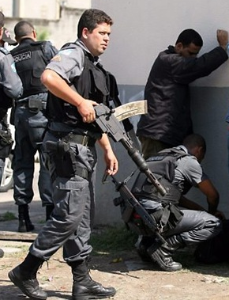

Messaging
Findings:
Unappealing messaging
Focus on law enforcement in developing countries

Slide 11

Messaging
Recommendations:
Create compelling messaging focused on children
Craft a key message statement

Slide 12
Tactics and Tools
Findings:
Little communication with supporters
Untapped contact database
Overemphasis on events
Recommendations:
Shift some resources away from events and towards stewardship
Optimize and harness contact database

Slide 13
Human Resources
Findings:
Lack of fundraising expertise and guidance
Lack of communications personnel
Recommendations:
Governance support (subcommittees)
Secure:
Fundraiser
Communicator

Slide 14

Evaluation Criteria
Surveys
Contact database
Website
Tracking against fundraising benchmarks
# of new supporters
# of repeat supporters
Average donation amount

Slide 15

Next Steps

Slide 16

Deliverables and Timeline
Final report (in progress)
Client presentation
Slide deck will serve as report summary
Completion by mid-March

Slide 17
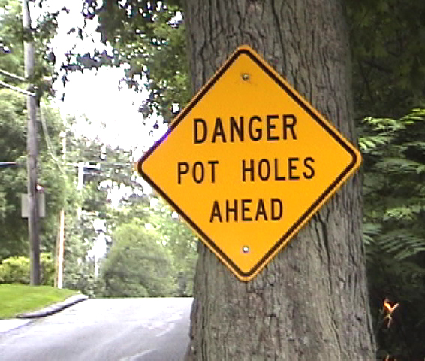
Challenges and Concerns
Getting our recommendations in front of the right audience
Ensuring that KINSA implements our recommendations

Slide 18

Discussion
Thank you for attending our presentation.

